Slide 1

Basic Graphing

Slide 2
ggplot2
Widely Used Basic Yet Powerful Visualization Package in R.
Designed for print-quality graphics in seconds.
11

Slide 3
ggplot Components
Data – The raw material of your visualization.
Aesthetics – The mappings of your data to the visualization.
Layers – A visualization requires at least one layer to render the data and aesthetics to the screen. These layers typically take the form of a ggplot2 geom function

Slide 4
The Grammar
Data – The raw material of your visualization
Layers – What you see on the plots (e.g., points, lines,etc.).
Scales – Maps the data to graphical output
Coordinates – The visualization’s perspective (e.g., a grid)
Faceting – Provides “visual drill-down” into the data
Themes – Controls the details of the display (e.g., fonts)

Slide 5
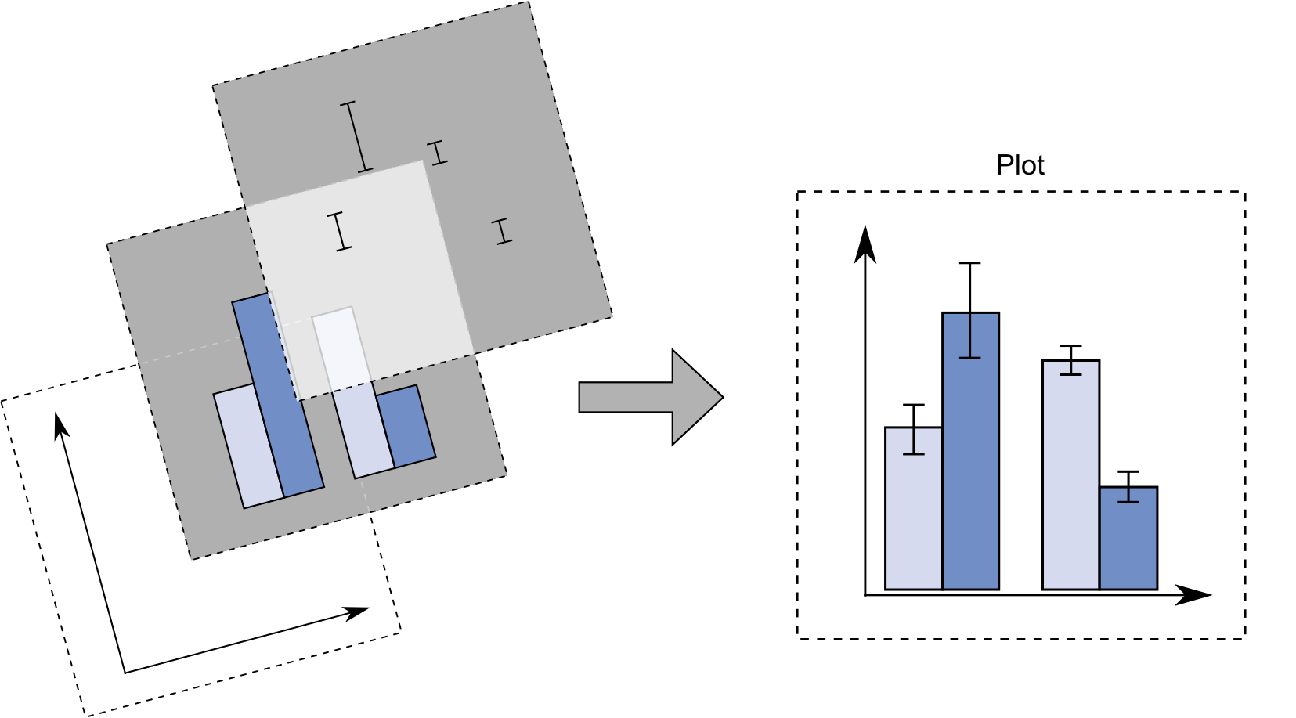
Layers
A graph is made up of a series of layers which are each customizable

Slide 6
Basic Plots in SAS and R
For Those Used to SAS

Slide 7
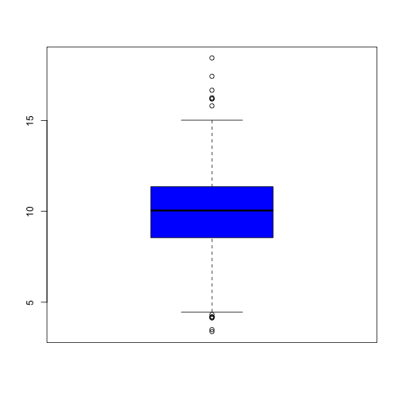
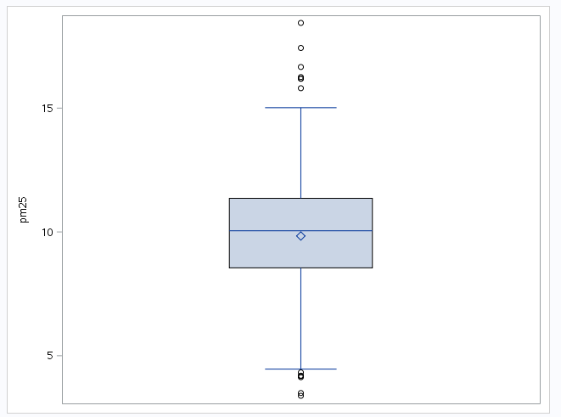
Boxplot
R
SAS
PROC SGPLOT DATA=WORK.POLLUTION;
VBOX pm25;
RUN;QUIT;
boxplot(pollution$pm25, col = "blue")

Slide 8
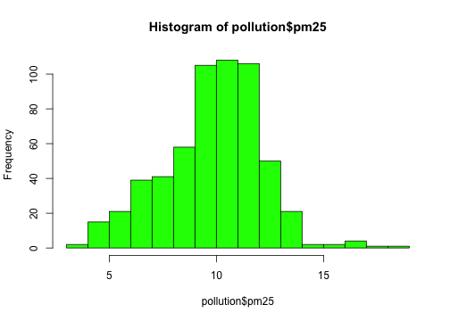
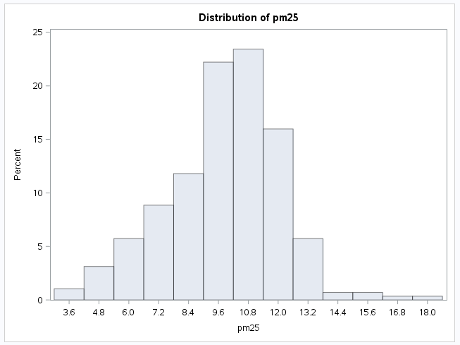
Histogram
R
SAS
hist(pollution$pm25, col = "green")
PROC UNIVARIATE DATA=WORK.POLLUTION NOPRINT;
VAR pm25;
HISTOGRAM ;
RUN; QUIT;

Slide 9
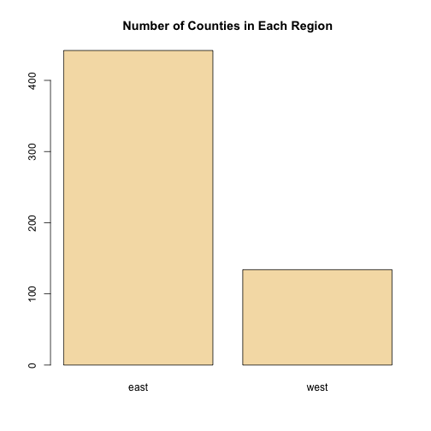
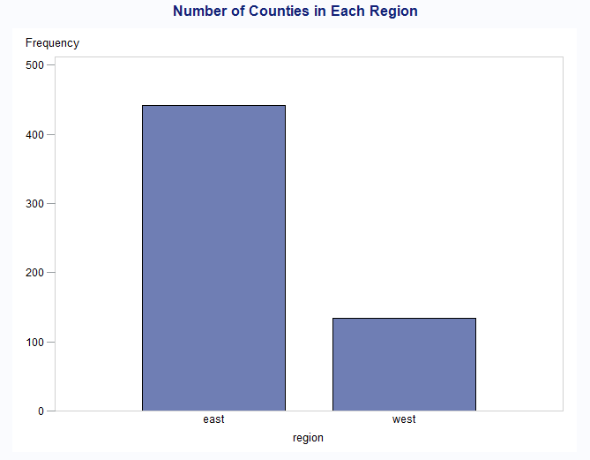
Barplot
R
SAS
barplot(table(pollution$region), col = "wheat", main = "Number of Counties in Each Region")
TITLE1 "Number of Counties in Each Region";
PROC GCHART DATA=WORK.POLLUTION;
VBAR region;
RUN; QUIT;

Slide 10
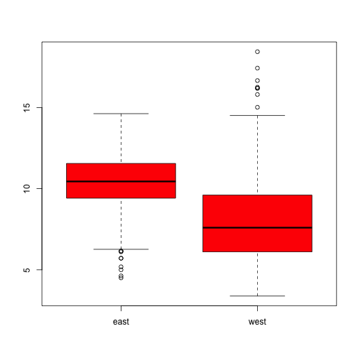
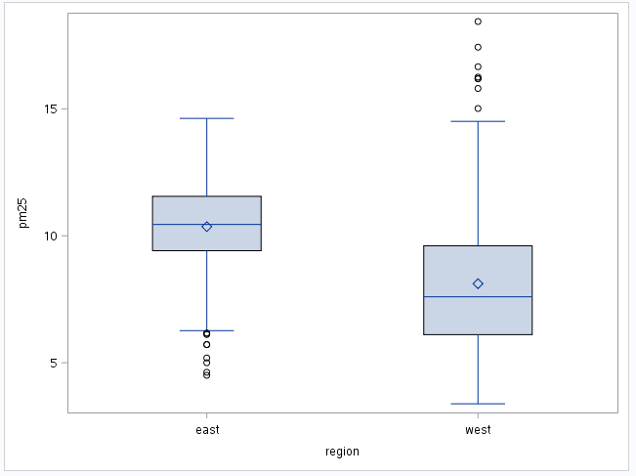
Multiple Boxplots
R
SAS
boxplot(pm25 ~ region, data = pollution, col = "red")
PROC SGPLOT DATA=WORK.POLLUTION;
VBOX pm25 /category= region;
RUN;

Slide 11
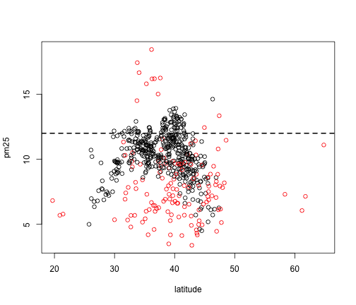
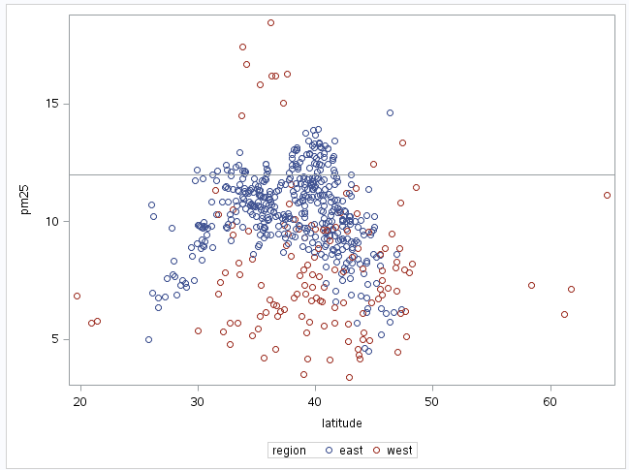
Scatterplot w/Color
R
SAS
with(pollution, plot(latitude, pm25, col = region))
abline(h = 12, lwd = 2, lty = 2)
proc sgplot data=work.avgpm25;
scatter x=latitude y=pm25 / group=region;
refline 12 /axis=y;
run;

Slide 12
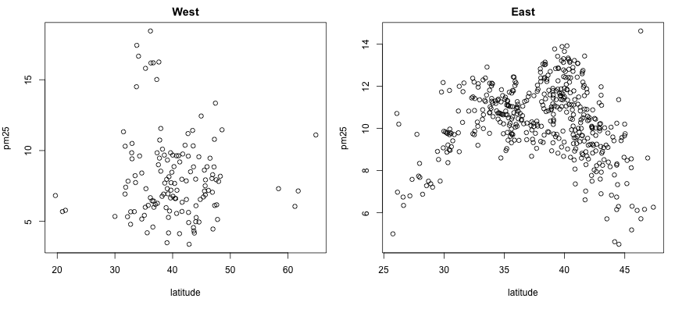
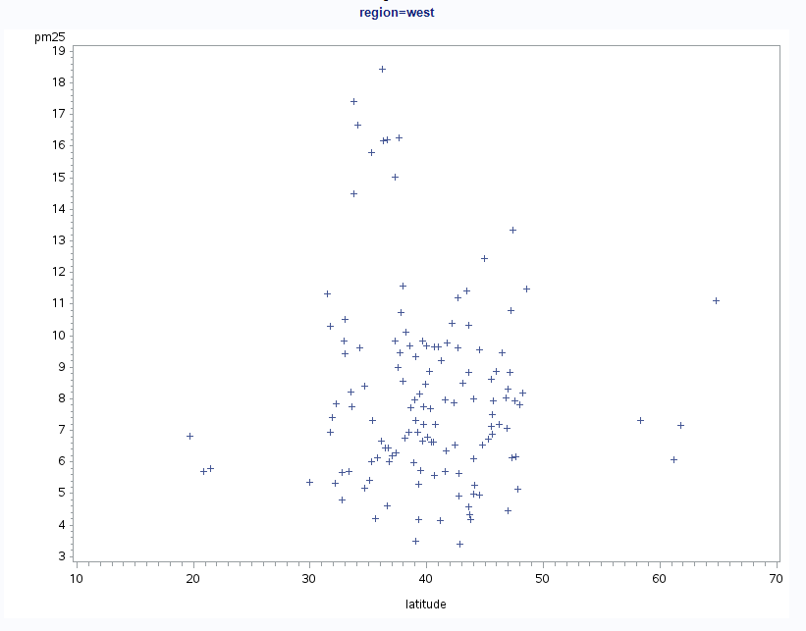
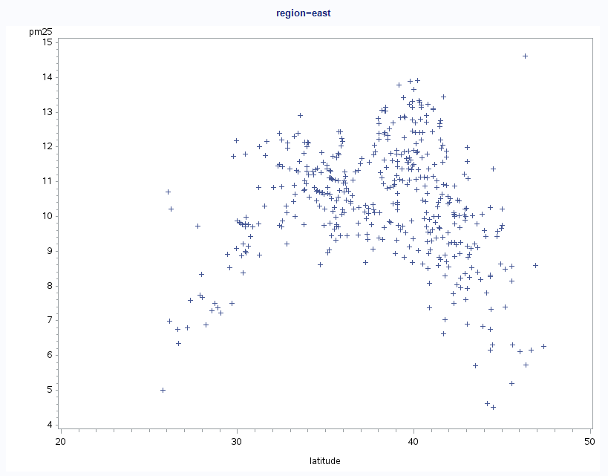
Multiple Scatterplots
R
SAS
par(mfrow = c(1, 2), mar = c(5, 4, 2, 1))
with(subset(pollution, region == "west"), plot(latitude, pm25, main = "West"))
with(subset(pollution, region == "east"), plot(latitude, pm25, main = "East"))
PROC GPLOT DATA=WORK.POLLUTION;
PLOT latitude * pm25;
BY region;
RUN;

